Slide 1


HOTEL AGGREGATOR ANALYSIS
HOTEL AGGREGATOR ANALYSIS
HOTEL AGGREGATOR ANALYSIS
BATCH – MIP-DA-07
SONIA DOGRA

Slide 2

Task-3
Analyze a hotel aggregator dataset using Power BI to visualize trends and factors affecting listing performance. Tasks include geographical insights, pricing analysis, host evaluation, review scores examination, and property/room type analysis. Deliverables include interactive dashboards and reports with recommendations for hosts and the platform

Slide 3

Problem Statement:
2024
This internship project aims to analyse a dataset of hotel aggregator listings using Power BI. The dataset comprises various attributes related to listings, hosts, reviews, and availability. The objective is to create comprehensive visualizations and insights that shed light on trends, patterns, and factors influencing the performance of listings. Through Power BI, interns will explore key metrics such as pricing, availability, host characteristics, and review scores to derive actionable insights for improving the overall quality and competitiveness of the listings.

Slide 4

Dataset Description:
1. id: Unique identifier for each listing.
2. listing_url: URL of the listing on the hotel aggregator platform.
3. scrape_id: Identifier for the data scraping event.
4. last_scraped: Date of the last data scrape.
5. source: Source of the listing information.
6. name: Name of the listing.
7. description: Description of the listing.
8. neighborhood_overview: Overview of the neighborhood where the listing is located.
9. picture_url: URL of the listing's picture.
10. host_id: Unique identifier for the host.
11. ... (and many more columns capturing details about hosts, location, property type, room details, amenities, pricing, availability, reviews, and other relevant information)

Slide 5

Project Objectives:
Geographical Insights:
- Visualize the distribution of listings on a map to identify popular neighborhoods.
- Explore the geographical concentration of listings and host locations.

Slide 6
Geographical Insights:
Utilize geographic visualization tools such as maps to plot the distribution of listings.
Use clustering techniques to identify popular neighborhoods with high concentrations of listings.
Overlay host locations to understand their distribution relative to the listings.

Slide 7


Pricing and Availability Analysis
Analyze pricing trends based on property types, room types, and accommodation capacity
Investigate the availability of listings over time and identify peak periods.

Slide 8
Pricing and Availability Analysis
Analyze pricing trends over time, considering factors such as property types, room types, and accommodation capacity.
Explore seasonality in pricing and identify peak periods of demand.
Investigate the availability of listings over time to understand fluctuations and identify any patterns.

Slide 9
Host Performance:
Evaluate host characteristics such as superhost status, response times, and verification methods.
Analyze how these host attributes correlate with listing performance metrics such as booking rates and review scores.
Identify any trends or best practices among high-performing hosts.

Slide 10
Review Scores and Guest Satisfaction
Examine review scores across various categories such as cleanliness, location, and communication.
Analyze how review scores impact overall listing performance and booking rates.
Provide insights into areas for improvement based on common themes or issues identified in guest reviews.

Slide 11
Property Type and Room Analysis
Analyze the distribution of property types (e.g., apartment, house) and room types (e.g., entire home, private room, shared room).
Explore trends in the popularity of specific accommodation setups and how they vary by location or host characteristics.
Provide recommendations for hosts based on the most in-demand property and room types.

Slide 12
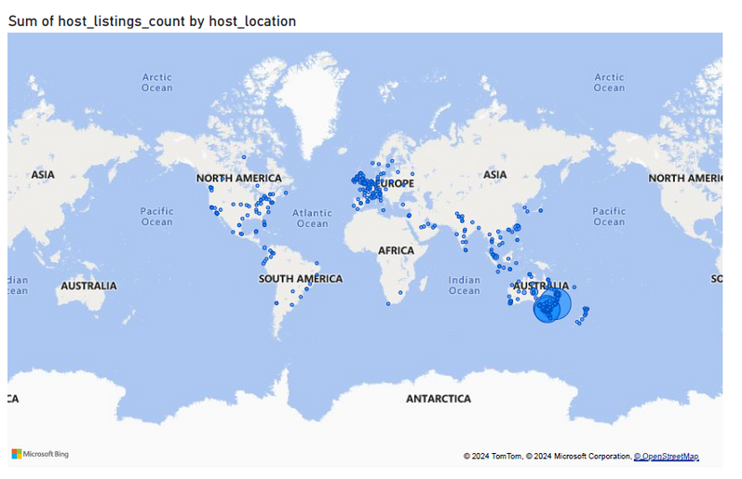
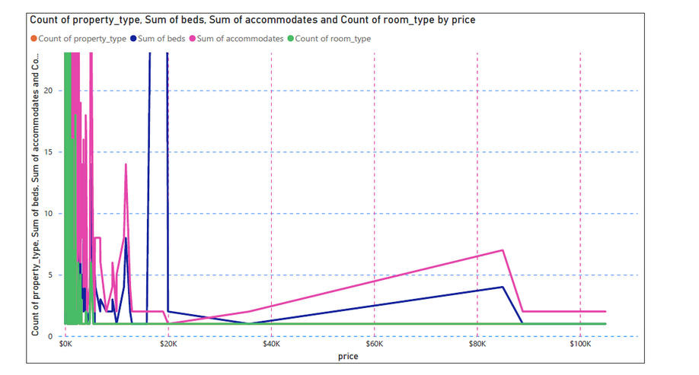
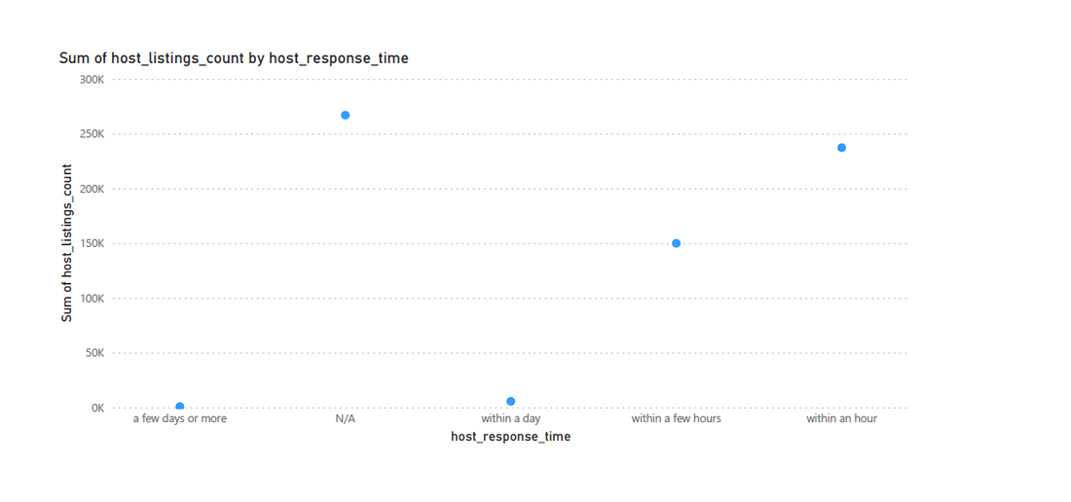
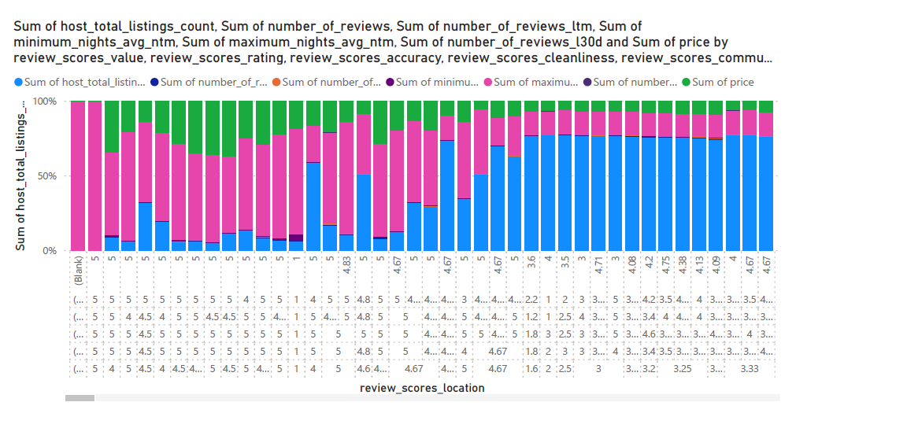
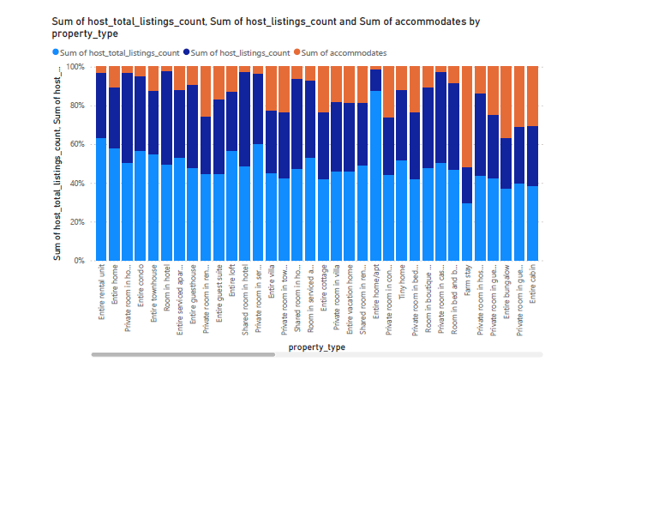

Slide 13
Conclusion
In conclusion, leveraging interactive Power BI dashboards facilitates clear visualization and communication of key insights, including geographical distribution, pricing trends, host characteristics, review scores, and property/room analysis. These dynamic visualizations enable stakeholders to grasp complex data patterns effectively. Additionally, comprehensive reports summarizing analysis findings and offering actionable recommendations empower hosts and the aggregator platform to make informed decisions. A structured approach ensures clarity and relevance, ensuring that the insights gleaned are actionable and beneficial for optimizing listing performance and enhancing guest satisfaction.

Slide 14
Thank You for Watching
Hotel Aggregator
Hotel Aggregator
Hotel Aggregator

